Slide 1
Basics of Python (Part 3)
Prof. Yong Won SEO, Ph.D.
College of Business and Economics
Chung-Ang University

Slide 2
Function
Basics of Python

Slide 3
Input values …
Function
(do something with input values, return an output)
Output

Slide 4
Grammar of function
def function name(argument 1, argument 2, ..) :
processing code
return result

Slide 5
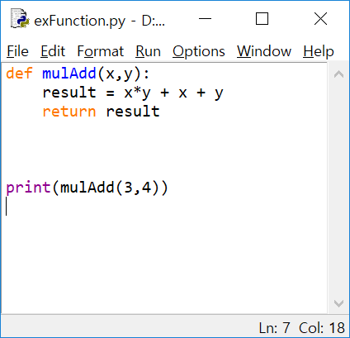
flow?

Slide 6
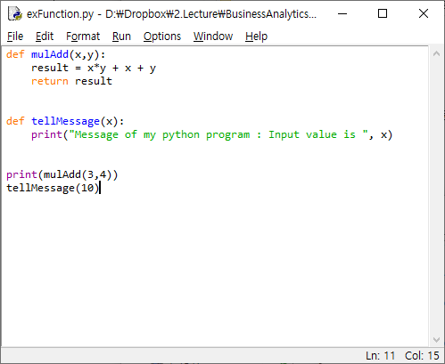
function with no return value

Slide 7
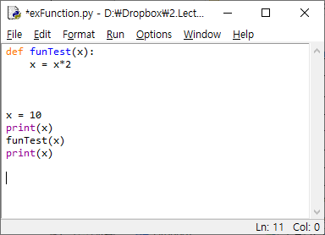
What will be output?
local vs. global variable

Slide 8
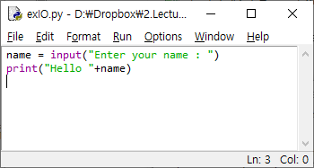
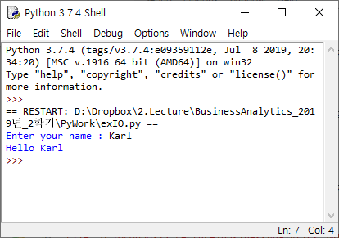
Keyboard input and console output

Slide 9
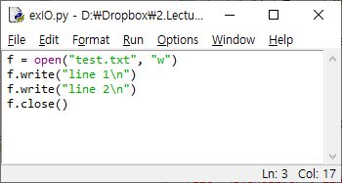
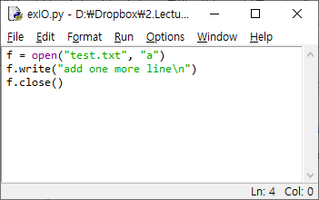
File output

Slide 10
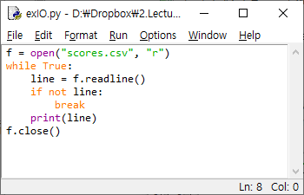
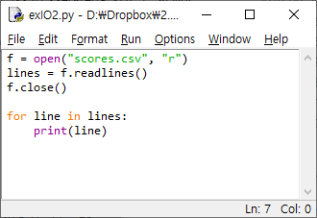
File input

Slide 11
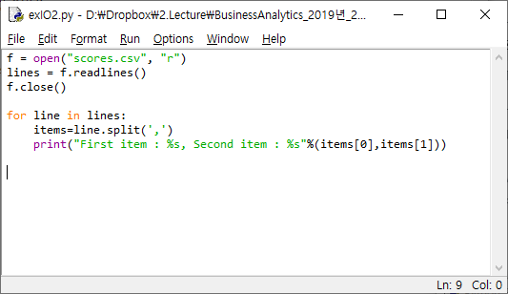
File input and split with comma

